Slide 1
Presentation for Team #22
Advenchore Quest: All Work All Play

Slide 2
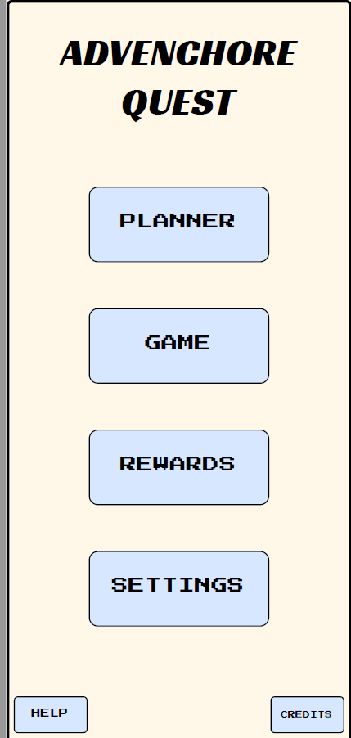
Introduction to Advenchore Quest

Slide 3
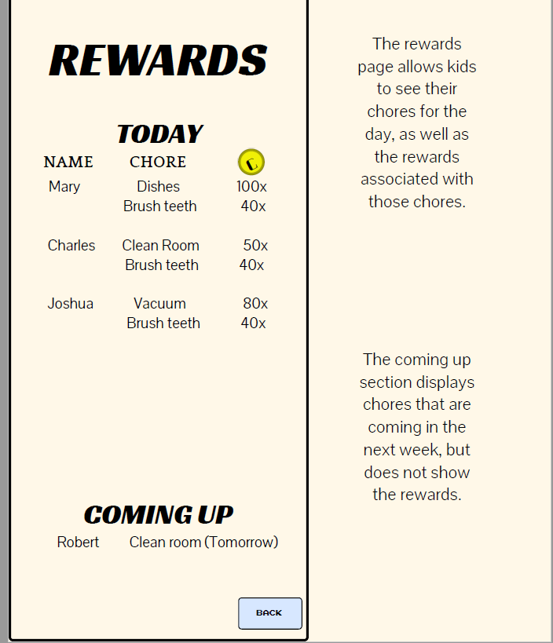
Reward System

Slide 4
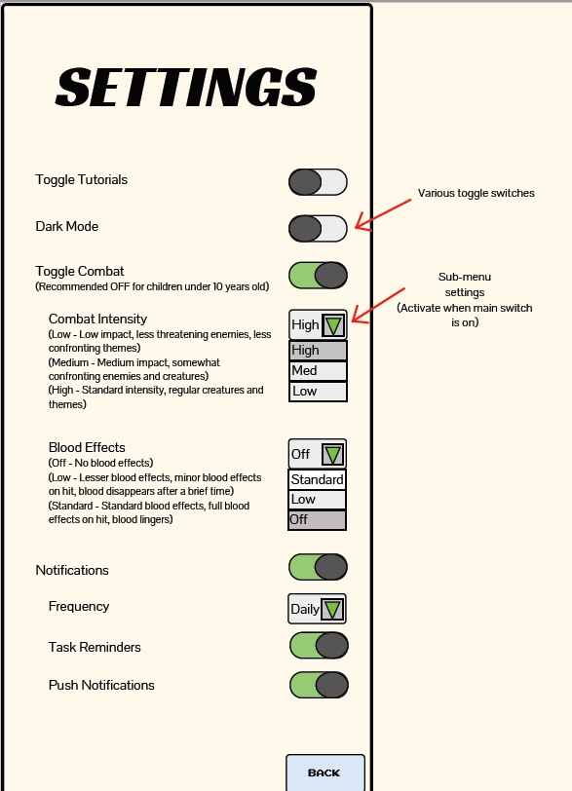
Settings and Security

Slide 5
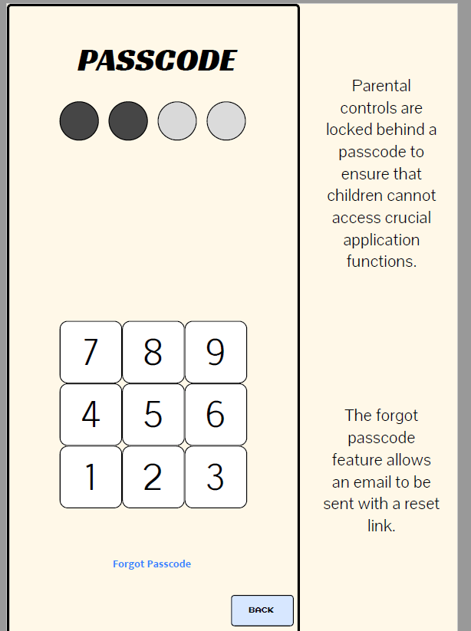
Settings and security (Cont.)

Slide 6
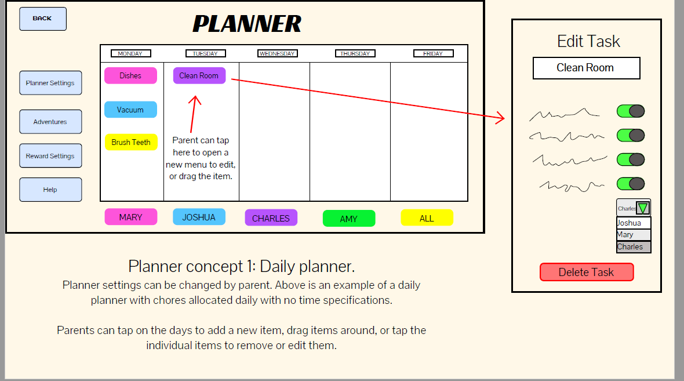
Planning chores and Rewards

Slide 7
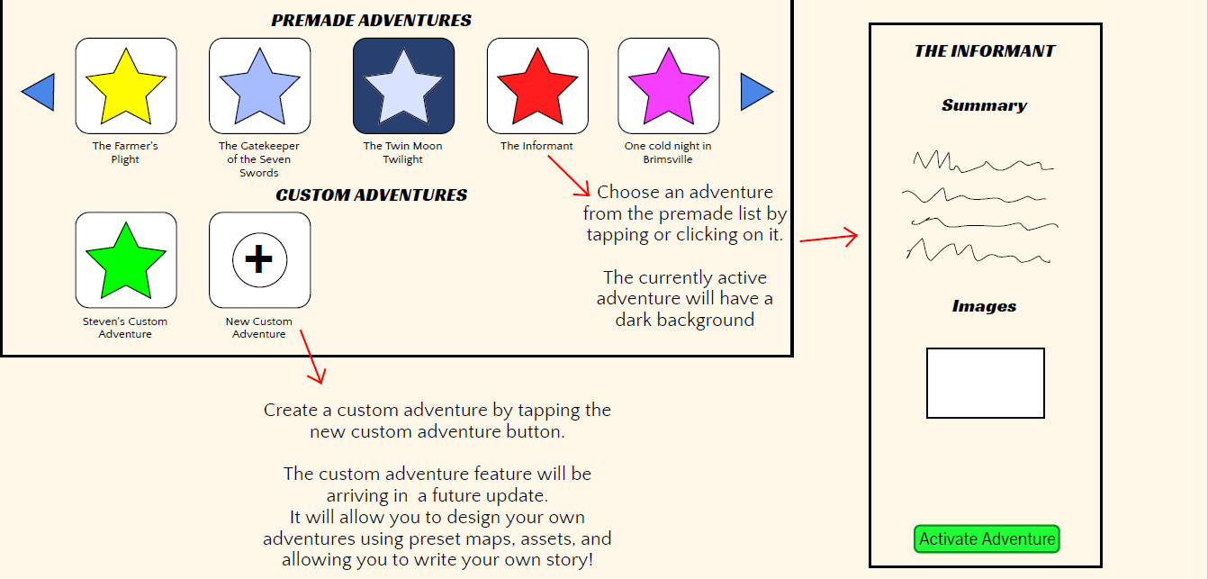
Planning an Adventure

Slide 8
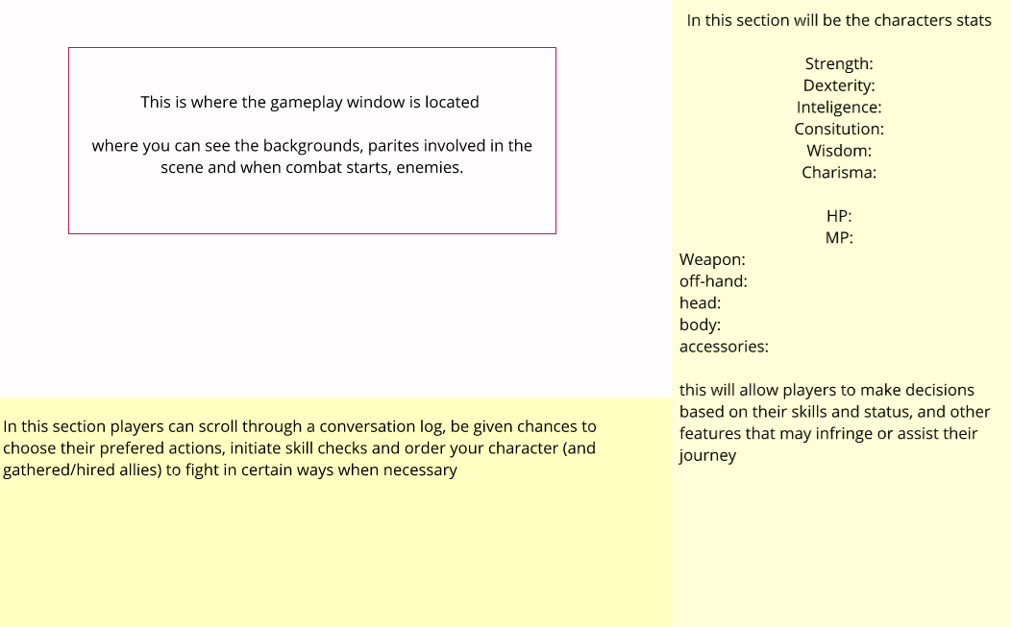
The game system

Slide 9
Summary of Our Project
We have decided the project be a game/application designed to foster health/healthier work ethics for young people.
We want the application to be user friendly between the parent and the child.
We also wished to focus on something current and stylised.

